Slide 1
Security Tools for Information Security
ENPM 685

Slide 2
Incident Response and Investigations

Slide 3

Modern Attackers

Slide 4
Modern Attackers

Slide 5
Modern Attackers
It’s about profit, information, and access
Attackers are well funded
“State actors”
Cybercriminal organizations (backed by ”traditional” organized crime?)
Targeted attacks
They do their homework
They customize their tools and infrastructure per victim

Slide 6
The Plan to Catch Attackers
Centrally log “all the things”
Signatures in log management or network based tools to find patterns that may indicate an attack
Common signs in logs of something suspicious
Alerts based off threat intel (internal, external)

Slide 7
Challenges with syslog
Not designed for security
No standard for messaging
Every app and platform logs events differently
All of these are the same thing!
src_ip
source_ip
s.ip
clientip

Slide 8
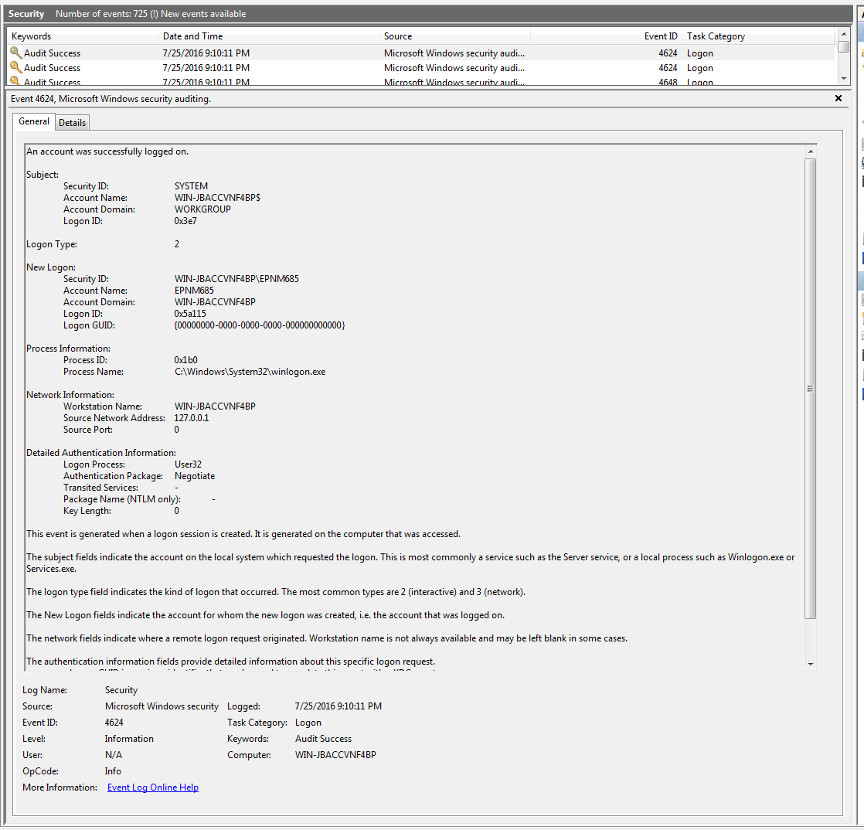
So Many Formats…
Jul 25 07:05:29 solberg kernel: [UFW BLOCK] IN=eth0 OUT= MAC=00:18:8b:10:c5:68:00:08:e3:ff:fc:68:08:00 SRC=186.112.110.170 DST=128.8.103.139 LEN=56 TOS=0x08 PREC=0x40 TTL=43 ID=46312 DF PROTO=TCP SPT=47509 DPT=23 WINDOW=5440 RES=0x00 SYN URGP=0
180.76.15.32 - - [24/Jul/2016:06:48:06 -0400] "GET / HTTP/1.1" 200 456 "-" "Mozilla/5.0 (compatible; Baiduspider/2.0; +http://www.baidu.com/search/spider.html)"

Slide 9
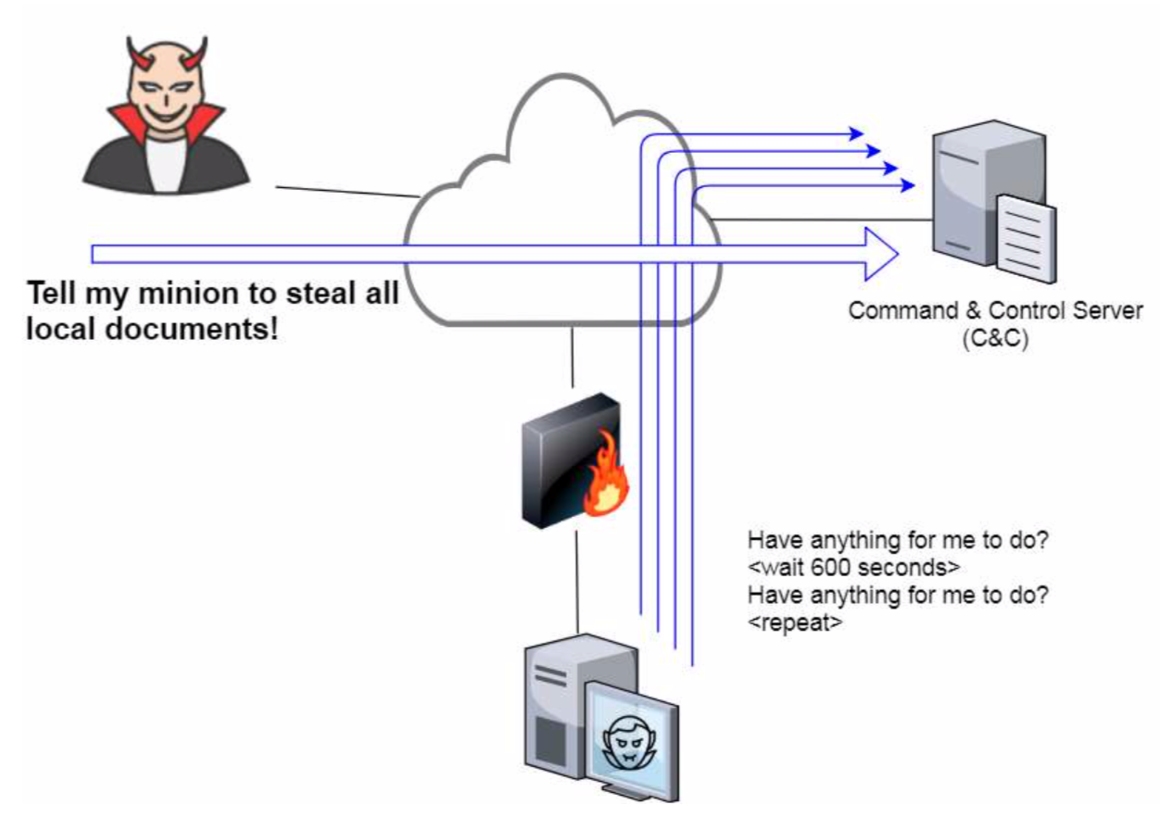
What is C2?
C2 = Command and control
The interaction between
Malware “implants”( or ”beacons”) installed on compromised systems
Server maintained by the attacker to remotely control compromised systems
Can be real time or scheduled jobs (typically the latter)
Interactions like
Load more malware
Set up persistence
Exfiltrate data

Slide 10
What is Data Exfiltration?
Unauthorized data transfer
Ex: Insider copies files to a USB drive and leaves the building
Ex: APT campaign compromises a organization and uses malware to move around the network and steals data, resulting in a data breach

Slide 11
Incident Response & Handling
Action plan for dealing with misuse of resources:
Intrusion
Malware
Data theft
Organizations should have written policy and procedures in place and practice them.
Practice makes perfect.
Denial of Service
Etc.

Slide 12
Plan vs Procedures
Incident Response Plan (Policy) – Define the incident response program at a high level. Who does what? What are the overall rules and goals of the organization? Strategic
Incident Response Procedures – Steps to take to handle a specific incident type. These steps typically have some ”wiggle” room to cover an attack type (malware/Ransomware) vs a specific attack (Tesla malware) Tactical

Slide 13
Strategy vs Tactical
Strategy: Long term plan to achieve a desired end goal
“View from the balcony”
Tactical: Actions taken to complete the strategic goal
”View from the field”

Slide 14
Strategy vs Tactical
"All men can see the tactics whereby I conquer, but what none can see is the strategy out of which victory is evolved."
- Sun Tzu, The Art of War

Slide 15
What is an Incident?
Adverse event or threat of an event in IT.
The definition of an event/incident can vary widely depending on if you are a intelligence agency or a flower seed manufacturer.

Slide 16
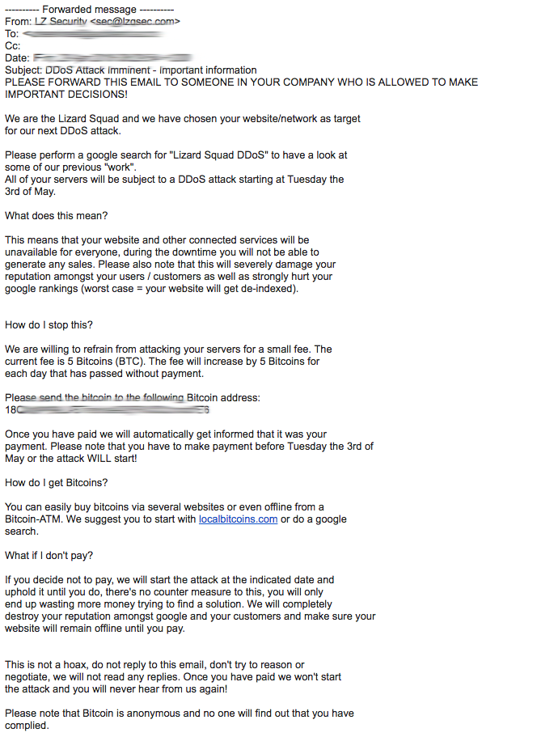

Slide 17
Incident Examples
Unauthorized use of a user account by someone else
Unauthorized use of privileges, or attempt to escalate privileges
Execution of malicious or unauthorized code

Slide 18
Event -> Incident
Millions of events/day on a typical medium-sized network
Identifying events that should become incidents involves:
Seeing them
Looking at context
Knowing your environment
Ex: UMD Palo Alto 30 day average – 10.1 million alert/block events a day

Slide 19
Incident Criticality
Not all incidents are equal in their severity and threat to the organization.
Example: A virus that infects several computers in a non-critical area of the organization will dictate a different level of response than an active compromise of a server critical to your organization’s survival.

Slide 20
Incident Response Plan
A document (policy) outlining
The organization’s incident response strategy
Roles and responsibilities
Procedures for each phase of the incident response process
Communication plan
Lessons learned plan

Slide 21


Policy
Policy is a tool!
A very valuable tool!
Policy beats technical tools every time.

Slide 22

Authority Grant
Your incident response plan (or SOC charter if SOC is responsible for IR) should have an authority grant to empower the IR team to perform their jobs.
This is critical to bypass
politics and stop the
incident

Slide 23
Typical Outline of an IR Plan
Purpose
Scope
Audience
Definitions
Incident Response Steps
Communications Plan
Appendices (often worksheets/notification charts/specific procedures/etc)

Slide 24
Incident Handling – 6 Steps
Preparation
Detection
Containment
Eradication
Recovery
Lessons Learned

Slide 25
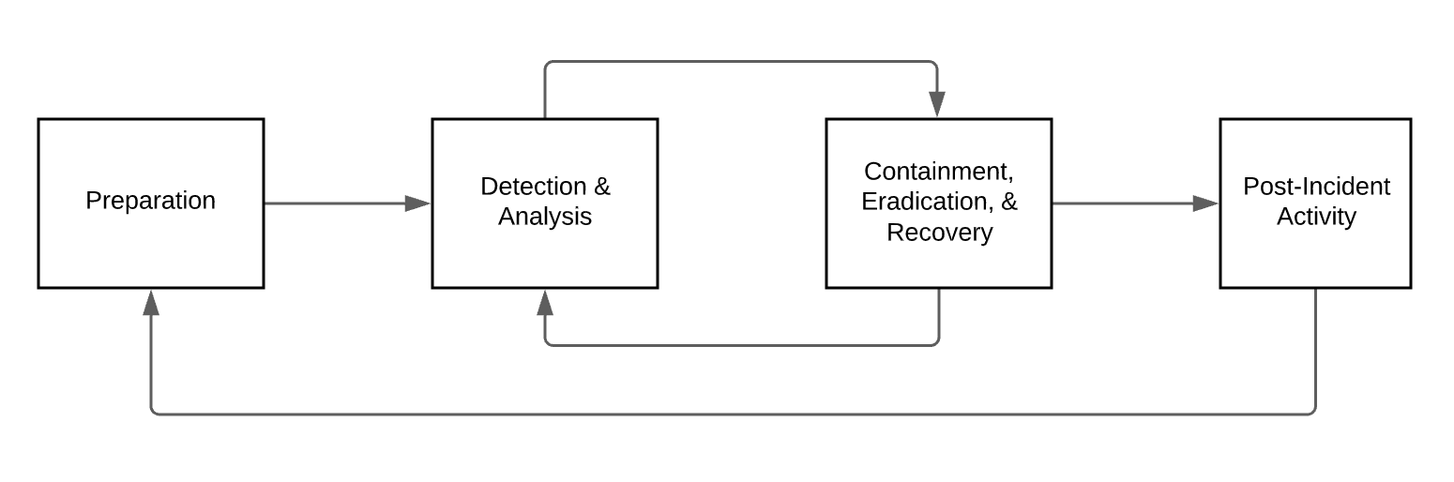
NIST SP 800-61 Rev 2
Incident Response Lifecycle

Slide 26
The Gold Standard
NIST SP800-61 rev2
http://nvlpubs.nist.gov/nistpubs/SpecialPublications/NIST.SP.800-61r2.pdf

Slide 27
Preparation
Ongoing state
Policy and p rocedures in place
Identify people involved - build a team
Have a communications plan
Identify resources, supplies, space, etc.

Slide 28
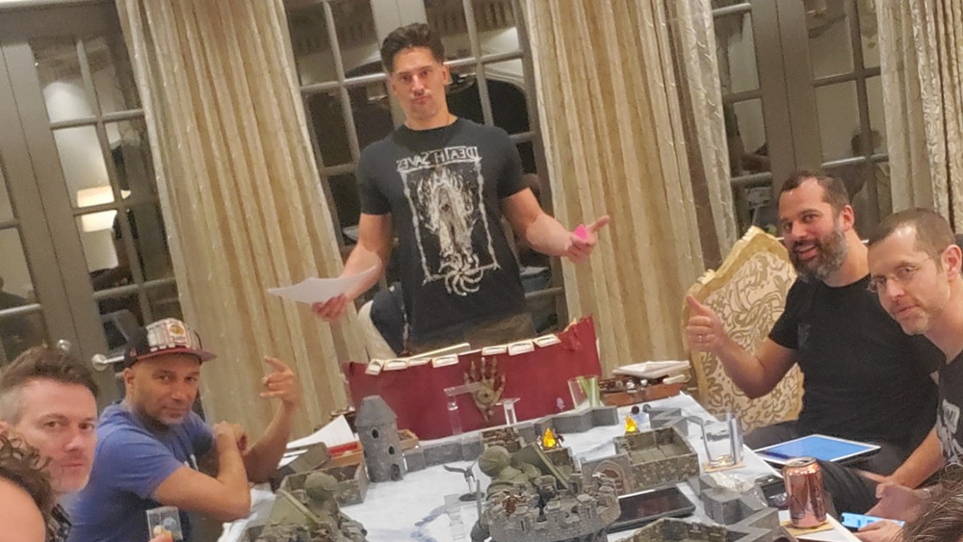
Tabletop Exercises

Slide 29
Tabletop Exercises
A simulation of an IT security event that is likely to impact your organization
This should have more that just the IR or security team involved – relevant IT people, IT leadership, communications team, organizational leadership
Can people think on their feet, do they know their roles, are there plans/procedures in place for various tasks?

Slide 30
Tabletop Exercise Examples
Phishing attack
Ransomware attack
Malicious insider
Advanced Persistent Threat actor
Blended threats (controversial speaker giving a talk with live protests/physical asset damage as well as DoS/hackitivism response)

Slide 31
Tabletop Exercises
CISA has a variety of “packages” available to enable you to run your own tabletop exercises
https://www.cisa.gov/cisa-tabletop-exercises-packages

Slide 32
Ransomware Tabletop Exercise
Day 1: 12:30 p.m.
Your IT staff conducts a routine review of intrusion detection system logs and discovers unusual traffic on your organization’s printer ports. There is a significant amount of data leaving the printer ports and going to external IP addresses.
Day 1: 3:30 p.m.
Your employees notice several cosmetic changes to the organization’s website. They also note that a commonly used link now directs users to an unrelated website.

Slide 33
Ransomware Tabletop Exercise
Day 2: 9:00 a.m.
Red screens appear on computers throughout your organization. All appear to have been infected with the same ransomware. A message is displayed demanding payment of Bitcoin, valued at approximately $5,300,000.00, for the decryption key and warning the key will expire unless payment is received within 48 hours.

Slide 34
Ransomware Tabletop Exercise
Day 3: 9:30 a.m.
A security researcher uncovers a series of posts on the Dark Web and contacts your organization. The researcher believes that the posts purporting to be from a well-known hacker group are genuine and the threat actors have gained access to personally identifiable information (PII), including employee social security numbers. The hacker group has provided a small number of data records to verify their claims and are willing to sell the information for “the right price.”
Day 4: 10:00 a.m.
Several media outlets contact your organization seeking comment about your ransomware infection and the data breach.

Slide 35
Ransomware Tabletop Exercise
Ransomware has crippled your organization’s IT
(Some) questions to answer:
Pay the ransom or to rebuild? Who decides?
Enterprise wide password resets
What needs to happen?
Are procedures in place?
Spinning up temporary services
Communications plan

Slide 36
“You can’t investigate critical/sensitive system/network because they are critical/sensitive to our organization!”
If it’s critical to your organization it’s critical to an attacker!

Slide 37
Some Items Discovered
“We have back ups, they are stored locally on the D drive of the server.” – That doesn’t do you much good if the whole server is encrypted?
”You don’t need to back up network appliances.” – Have you heard of router/firewall/etc configuration. How fast and accurately can you recreate that on the fly?
“This critical service runs on a single server and can only have an hour of downtime.” – How long does it take to restore 1TB from tape/NAS/cloud?

Slide 38

Who’s Responsible for IR?
Security Team
IT Admins of compromised system

Slide 39
Incident Response Team
Leader IT Security IT subject matter experts (Windows, Unix, Networking, Apps, etc.) | Org Leadership Legal Privacy Risk Governance Communications

Slide 40
Incident Response Teams
The IR team CAN NOT just be the IT Security Team!
Teams often have the most success when the leader is organization savvy and has political capital to move fast and far.

Slide 41
Response Strategies
STAY CALM!
Take detailed, precise notes
When to contact law enforcement (if at all)?
Stop activity and fix immediately vs. watch and learn
Must have management buy-in on all these decisions

Slide 42
Team Organization
Define the team, leaders, and roles
Define communication procedures
Establish a response timetable
CHECKLISTS!
Train together (Tabletop exercises, drills, external training)

Slide 43
Why Define a Team Ahead of Time?
Defining a team in a time of crisis is rarely effective.
If a team is defined ahead of time
Roles can be assigned
Contact information shared
Backups identified
They can practice together

Slide 44
Communications Plan
Internal
Incident Response team
IT leadership
Organizational leadership
External
Public relations
Customers
Law enforcement / Government
Business partners

Slide 45
External Notifications
The law, contracts, and your internal policy will dictate this:
Notifying peers:
Business partners
Industry partners
Policy for notifying on breaches of your data NOT on your systems (home machines, contractors, etc.)
Talk to a lawyer for this one

Slide 46
Do Executives ”Need To Know”?
Who should make the decision if you should/should not pay the ransom in a ransomware incident?
This is NOT an IT decision, this is a business decision.
IR team should have a consulting role here.

Slide 47
Handy Jump Bag
This is the kit you have ready to go for incidents
Tools and supplies you might need for an incident

Slide 48
What to Include?
Hardware/Software for creating images
Tableau duplicators
dd, windd, Netcat/Socat/Cryptcat, Safeback, Ghost
Forensic Software
The Sleuth Kit, Autopsy, EnCase, FTK, X-Ways, etc.

Slide 49
Hardware
A few clean large USB drives
Ethernet Tap
Patch Cables
Laptop w/ multiple OSes

Slide 50
More Stuff
List of team members and contact information
Anti-static evidence bags, desiccants
Notebooks (hard-bound), pens, printed versions of incident forms
Advil
Tums
Caffeine
Local carryout menus

Slide 51
Bits and Pieces
Pens
Paper
Jumpers
Flashlight
Screwdrivers
Tweezers
Mirrors
i-device tools
Batteries
Assorted cables (firewire/thunderboltUSB/mini/micro)
Magnifier
Sticky notes
Business cards

Slide 52
Detection
Detection involves gathering events and analyzing them
You’re looking for harm or intent to harm
Deviations from the norm are good places to start looking

Slide 53
Alert Early…
…for your critical systems and users
Better to identify some false alarms early than waiting too long and miss an attack
Bringing more data and minds to bear usually helps to clarify the situation
Situational awareness matters (you must have good intel)

Slide 54
Where Did The Alert Come From?
Alerting can happen at many locations
Border security device
Host-based device
Log analysis (manual or automated)
User/Administrator detecting something abnormal

Slide 55
High Value Alerts
Typically in order from most valuable to least: *
User/Admin noticing abnormal behavior
Log analysis
Host-based alert
Network-based alert
* As always take things with a grain of salt…

Slide 56
Assessment
Key to the Detection process
Is an Event an Incident?
Assess evidence in detail
Examine all possibilities
Consider the attacker’s likely methodology

Slide 57
Assessment Questions
How much damage could be caused?
What vulnerabilities are present?
Are exploits available?
What other related activity is observed?
How plausible is the scenario you’re projecting on this event?

Slide 58
Your Assessment
An analyst noticed an alert in your SIEM from your NGFW about a system on the network phoning home to a known C2 server
You have traced it back to a Windows 2012 server
It is vulnerable to MS17-010
It is part of a “special project” and isn’t part of your normal patch/server management
Has it been compromised? What’s your next step?

Slide 59
Your Assessment
Alert in your SIEM for an after hours login by a sysadmin is noticed during morning log review
Your scheduled maintenance window was last night
The server requires VPN + MFA access to connect to
Has it been compromised? What’s your next step?

Slide 60
Documentation
Once an incident is declared documentation needs to begin
Categorize
Characterize
What’s the severity
What type of data is involved
Classification help available: https://www.first.org/resources/guides/csirt_case_classification.html

Slide 61
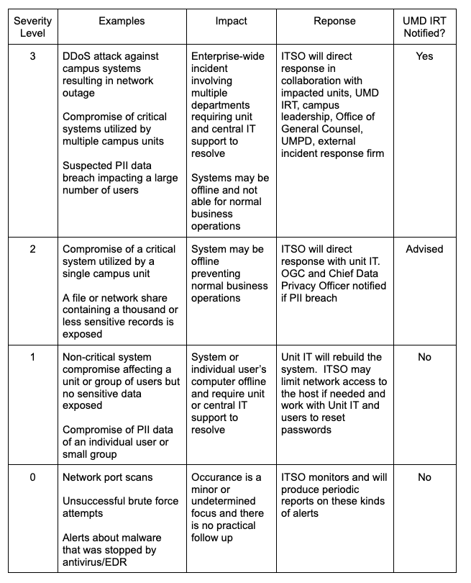

Slide 62
Documenting...
Some SIEM and Ticketing systems have IR forms baked in
Or you can craft your own inside them
Commercial solutions
ServiceNow Security Incident Response
And about a billion others
Open source solutions
TheHive - https://thehive-project.org/
FIR - https://github.com/certsocietegenerale/FIR

Slide 63
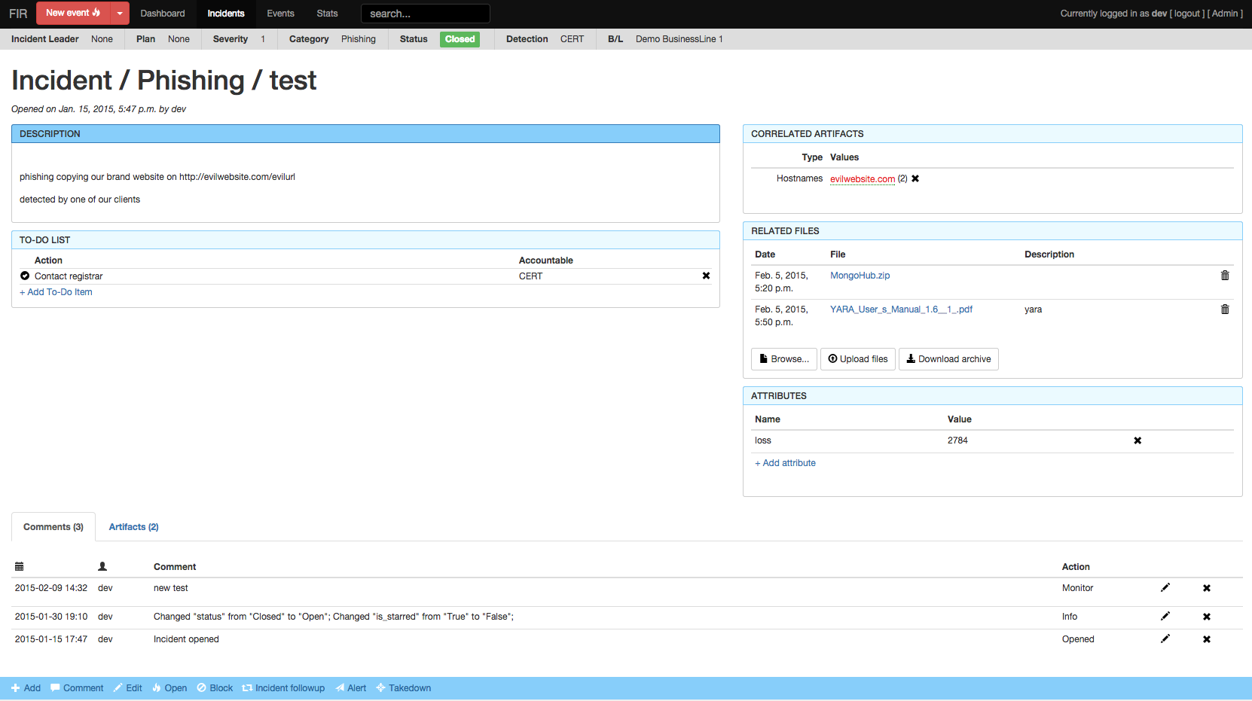
FIR

Slide 64
Remediate or Preserve?
At some point in your triage of the incident you will need to make the decision on if you should remediate and restore operations or preserve evidence.
Having context around the incident, the systems and services impacted and the likely goals of the attacker can help determine your best path forward.

Slide 65
Should You Restore Operations?
Are the impacted systems core to your organization and an outage is preventing your organization from functioning?
How big is the incident?
Can you identify the attacker?
What is the likelihood that the attacker would be prosecuted/punished?
If an internal employee terminate and litigate?

Slide 66
Should You Bring Law Enforcement In?
Benefits of engaging Law Enforcement (LE)
LE can demand records, logs, and other information from external resources (ISP, mobile provider, etc) via warrants and subpoenas
LE has additional tools, information, and resources that can assist in an investigation (although you may not be privy to the details)
If identified suspects can be ”brought to justice” and stopped from committing additional crimes
Some cyberinsurance polices may require LE engagement

Slide 67
Should You Bring Law Enforcement In?
Risks of engaging Law Enforcement (LE)
LE cares more about the law than your organization
LE may seize equipment that you may never see again or is destroyed in the evidence collecting process
Working with LE can slow the IR process down
LE will add an element of publicity to the incident

Slide 68
Should You Bring Law Enforcement In?
There should be a decision plan in your IR plan to determine when law enforcement is called in and also who decides if law enforcement is called.
Who from your organization should contact law enforcement?
Make sure to keep the law enforcement contact list up to date.

Slide 69
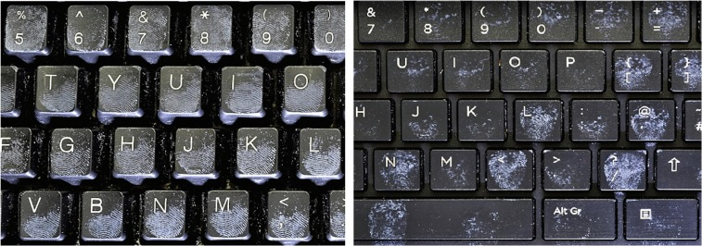
Should You Bring Law Enforcement In?
The ”scary guy” case…
https://www.justice.gov/archive/criminal/cybercrime/press-releases/2004/tereshchukPlea.htm

Slide 70
Questions to Consider
In terms of money, how much damage was done? Can you easily quantify that
Can you identify a suspect? Are they in the same country as your organization/law enforcement agency you contact?
How large/impactful is the incident to the organization?
Do you have enough evidence that a prosecutor will be able to convince a jury?
Are there legal requirements to report the incident to law enforcement?

Slide 71
Should You?
Legally bound to report? Yes
Insider you have identified caused significant enough damage? Maybe
Malware on a critical system the organization needs back ASAP? Probably not

Slide 72
Containment
Stop the damage
Isolate systems
Remove
Create images for investigation?

Slide 73
Short-Term Containment
Prevent further damage
Don’t taint evidence

Slide 74
Short-Term Options
Pull network cable
Pull power cable (no graceful shutdowns)
Isolate machine using network management tools (quarantine VLAN)
Create same effect with Firewalls
Point DNS record elsewhere

Slide 75
Should You Be Sneaky?
Don’t let the attacker see that you’re onto them
Avoid using intrusive methods of investigation
Analyze the images you’re creating

Slide 76
Assess Risk of Ongoing Operations
Examine logs and other information acquired
How far along is this attack?
Has the attacker accesses sensitive data/systems?

Slide 77
Long-Term Containment
We can start making changes once we have all of our images
Ideally, we drop the system, nuke it and rebuild from scratch or a high-confidence backup (Eradication)
If it must stay up, then...

Slide 78
Long-Term Containment
Patch
Patch “neighbors”
Change passwords
Alter trust relationships
Firewall/isolate
Remove items (accounts, tools) used by attacker
Shutdown attacker processes

Slide 79
Long-Term Containment is a Band-Aid
Don’t confuse this with Eradication
It is a less-than-ideal option

Slide 80
Containment is Risky
Real world containment will break applications/connectivity
Prevent users from doing their job
Cost the organization money

Slide 81
Eradication
Wipe traces of the attacker from the machine/network
Determine cause of breach

Slide 82
Restoration
Locate the most recent CLEAN backup
It is very important to identify when the attack occurred so you can get this bit correct
Wipe the drive (not just a format) before reinstall

Slide 83
Nuclear Arsenal
DBAN - Darik’s Boot and Nuke
^{www.dban.org}
Hardware-based wipers
Most imaging hardware will also wipe
Shred drive/system and start from scratch?

Slide 84
Don’t Clean Machines
Malware is spectacularly complex and difficult to remove
A compromised machine can never be trusted again
“Nuke and Pave”

Slide 85
After System has been Restored
Patch
Check configurations
Vulnerability scans
Network scans
Assuming you’ve scared the attacker off and determined out how they got in, make sure that entry method won’t happen again.

Slide 86
Recovery
Monitor system with stakeholders
Look for signs of a return of the attacker
Logs deserve careful scrutiny

Slide 87
Lessons Learned
What happened?
How do we improve operations so it won’t happen again?
THIS IS THE MOST IMPORTANT STEP
(IMHO)

Slide 88
Lessons Learned
Develop a report to attach to the incident report
Provides a basis for metrics
Provides a basis for funding to improve security posture, too
Avoid finger pointing

Slide 89
Finally, 7 Critical Mistakes
Fail to report or ask for help
Incomplete/non-existent notes
Mishandling/destroying evidence
Failure to create working images
Failure to contain or eradicate
Failure to prevent recurrence of compromise
Failure to apply lessons learned

Slide 90
Threat Hunting
IR work is typically reactionary
What if we are proactive and try to find evil on our network when it is just a compromise and not a breach?
Or is this just a “cooler” rebranding of Incident Response?

Slide 91
What Threat Hunting Should Be
An analysis and access to all systems
Assume nothing
Deliverable is an assessment on if the organization is compromised or not
3 dispositions
The system is no compromised (this is a good thing!)
The system is compromised (IR to follow)
I’m not sure so I will investigate further

Slide 92
Threat Hunting Investigation Types
Looking for known Indicators of Compromise (IOCs)
Utilize your catalog of know IoCs to search against in your logs to find ongoing attack/compromise activity in your environment
Analytics/machine learning
Use all the fancy/$ buzzwords to review log data and find irregularities/patterns to review.
Hypothesis-driven investigations
Discover new tactics, techniques, procedures (TTPs) via research/shared intel and investigate on your own network

Slide 93
Intel / Attribution
What can you learn about the attacker?
What tools do they use?
What’s their C&C infrastructure?
Who are their targets?
What is their motivation?

Slide 94
Incident Response - Tools
Log Management Tools
Security Event Information Management Tools (SEIM)
Automatic Malware Analysis tools
Endpoint Detection & Response (EDR)
…more about these the next 2 weeks!

Slide 95
…also
ENPM687 – Digital Forensics and Incident Response
Get deeper into the technical hands on parts of host based incident response with digital forensics.

